Slide 1
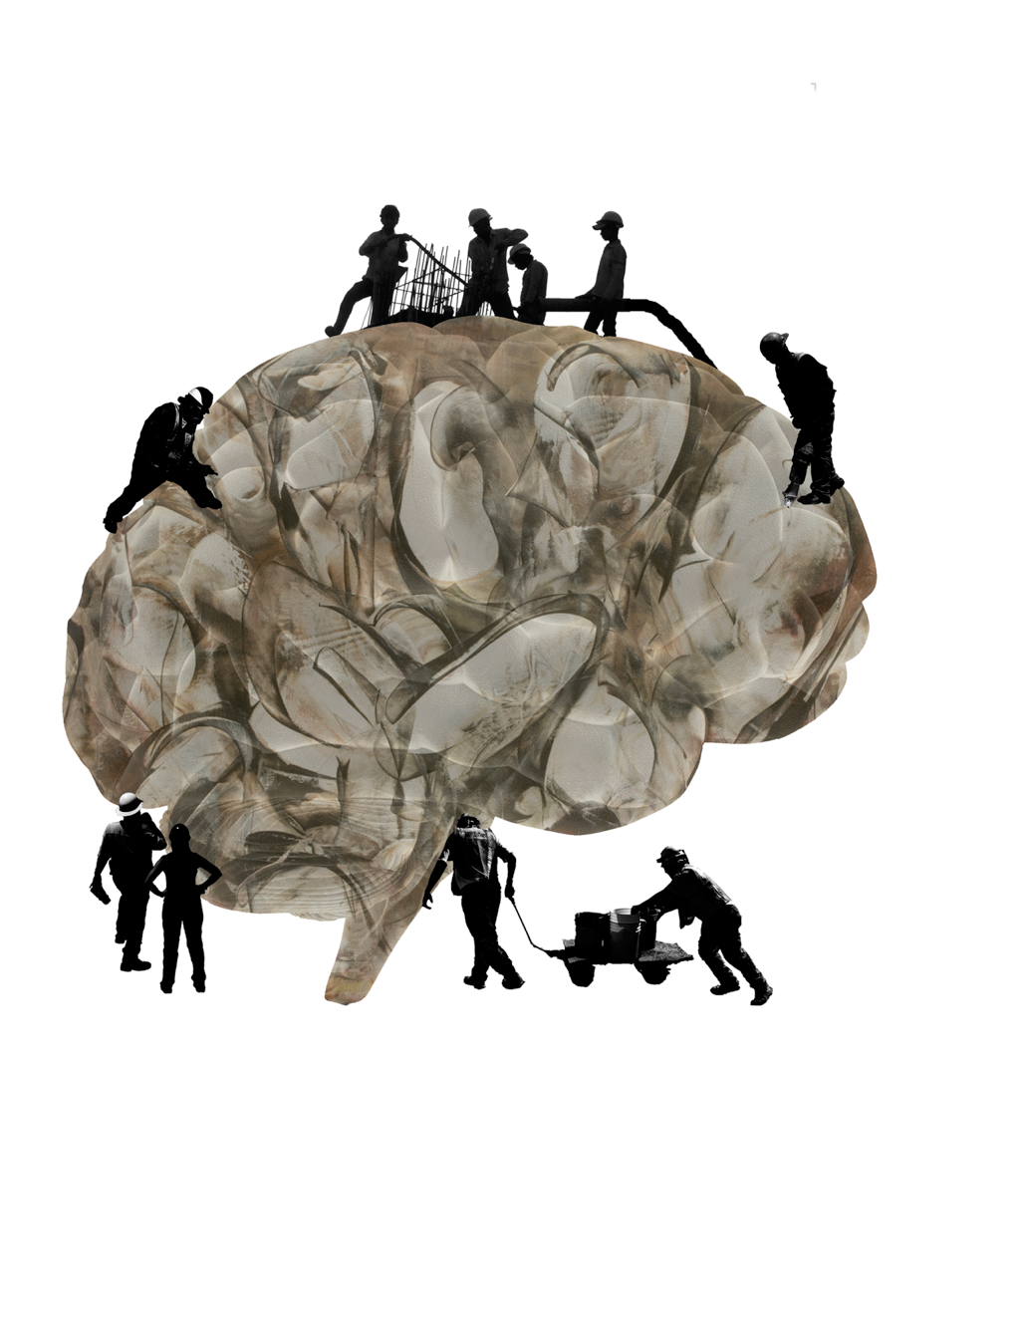

Spatial Semantic Pointers (SSPs)
Chris Eliasmith
SYDE 556/750
Notes:
- reluctant to pursue real research interests, not respectable
- so built lots of models: lamprey swimming, working memory, path integration in the rat, neural integrator for eye control, various decision circuits

Slide 2
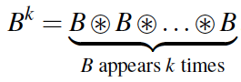
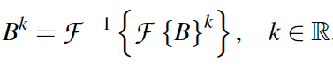
Spatial Semantic Pointers
Semantic pointers represent standard discrete structures (lists, trees, etc.)
SSPs allow recurrent convolutions to have fractional powers
Compute fractional k in Fourier space

Slide 3
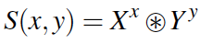
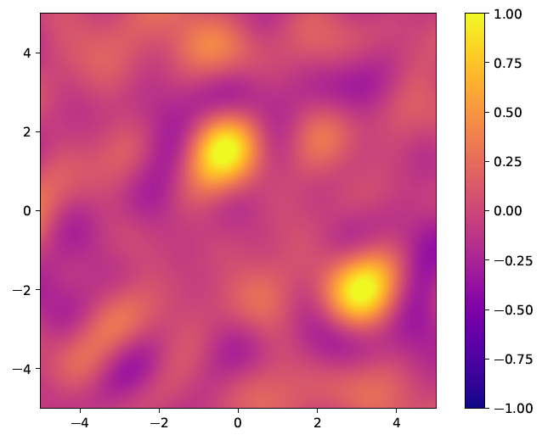
Spatial Semantic Pointers
Represent continuous space (Clifford torus)
Heat map to visualize vector contents
Dot product between SSP at every possible position and S
Notes:
Clifford torus: preserves Euclidean geometry. This is a generalization to any number of dimensions of the torus (usually just 4D); ‘proper’ cartesian product of circles (not a 3 torus)

Slide 4
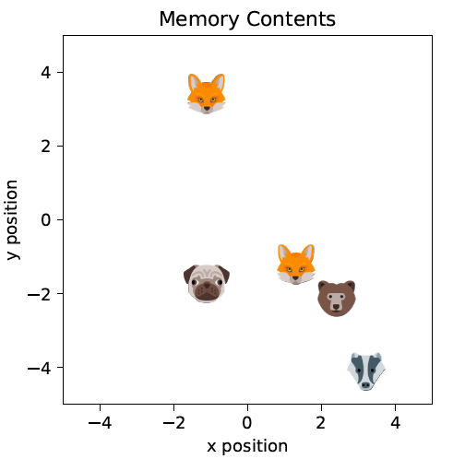
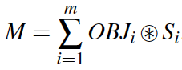
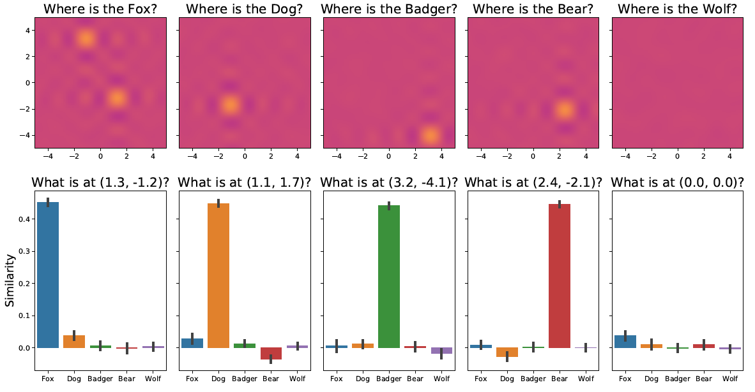

Slide 5
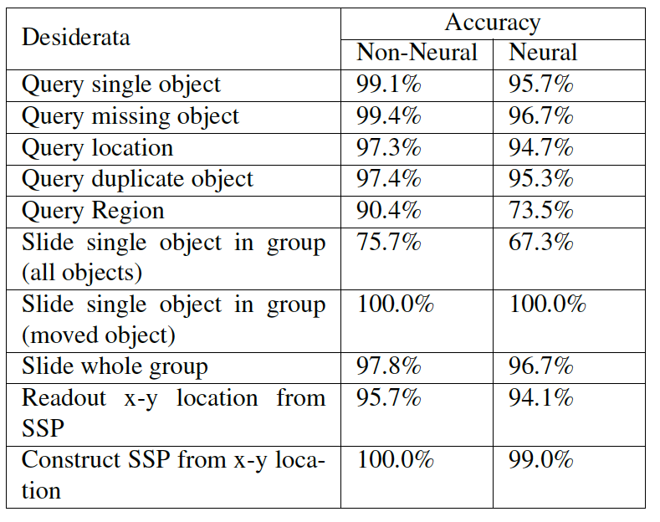
Spatial Manipulations

Slide 6
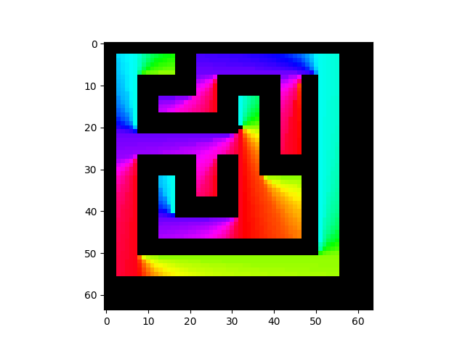
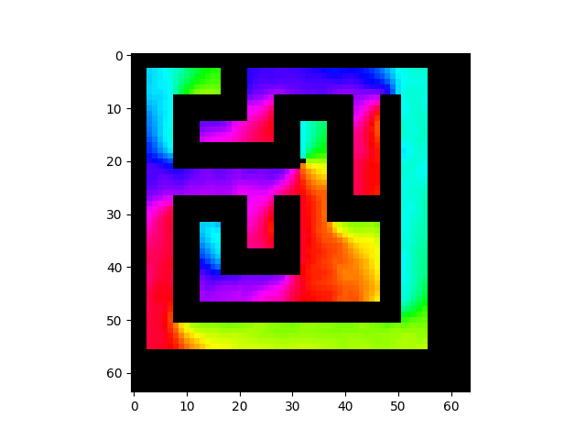
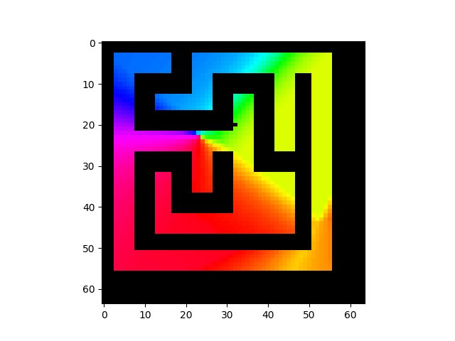

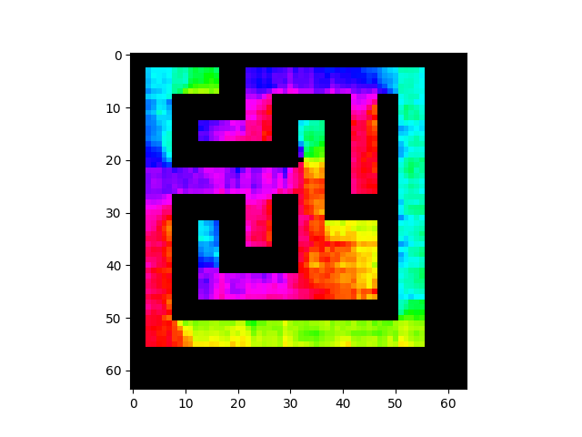
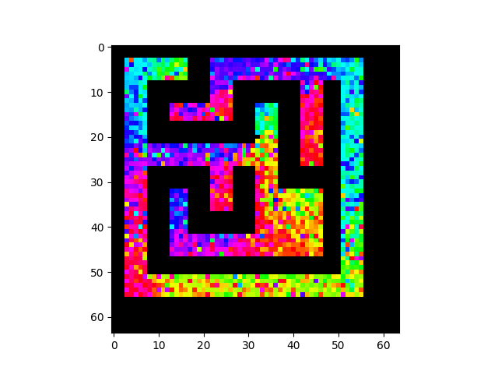
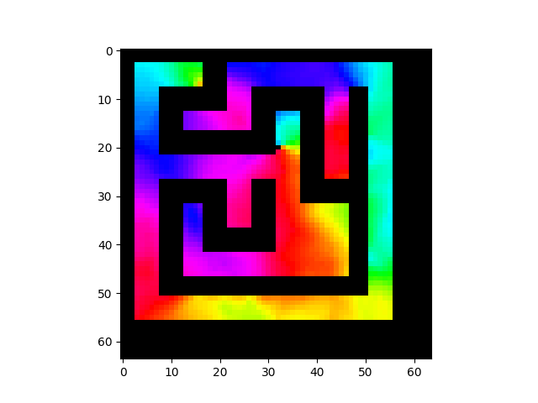

Navigating to Goal
Ground Truth
RMSE: 0
SSPs
RMSE: 0.0529
Random Projection
RMSE: 0.5351
Single layer MLP, same for each encoding (tried many more).
Trig Functions
RMSE: 0.1350
Random Mapping
RMSE: 0.2580
2D Coordinates
RMSE 0.1984
Legend
Up
Left
Right
Down
Notes:
Keep diagram on this slide, and explain the different methods

Slide 7
Scaling
Example 10x10 joined, hierarchical environment

Slide 8
Scaling
Performance of different encoders on 10x10 large maze from any point to any other

Slide 9
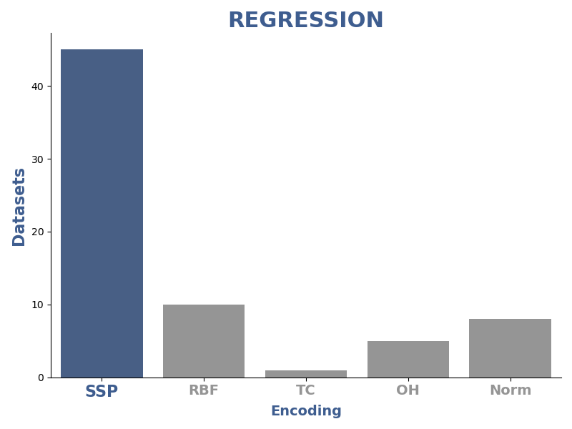
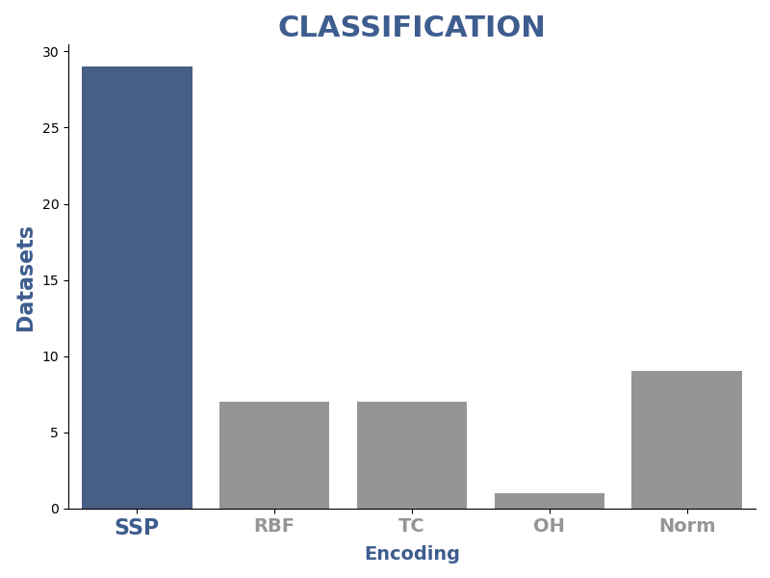
Good for General ML
SSPs are more accurate on a large majority of 122 standard ML benchmarks.

Slide 10
How to Choose Axis Vectors
Randomly (examples til now)
Tuning curves of neurons with random axis vectors and evenly tiled SSPs as encoders

Slide 11
How to Choose Axis Vectors
With plane wave structure
Tuning curves of neurons with structured axis vectors and encoders picking out plane waves

Slide 12
How to Choose Axis Vectors
Sums of planar waves

Slide 13
Grid Cells
With plane wave structure, spiking neurons give grid cell responses
We can combine them to get place cells (with standard NEF decoders)
SSP Grid cells

Slide 14
Place Cells

Slide 15
Mathematical properties
Euclidean space is preserved on a high-d torus
E.g.,
We get the benefits of high-d representation, with accurate low-d Euclidean representation

Slide 16
Cognitive SLAM
SLAM with complex features at certain spatial locations
Start with no knowledge, bind vector descriptions to particular location in space
Combines spatial and ‘symbol’ repn in neural network
Semantic map as opposed to standard ‘image registration’ map

Slide 17
Cognitive SLAM Model
Full Model
Path Integrator
Path integrator tracks ego position from velocity
SLAM model learns env map, outputs allo- and ego-centric position

Slide 18
Path Integration
One-minute long paths in 2D and 3D, spiking network

Slide 19
Cognitive SLAM
Learns env by end of 20s path, full spiking
Scaling up; symbols ‘over’ space
Notes:
(a) The path and
items along it (marked by coloured shapes). The ‘x’ markers
indicate recalled item locations at the end of the simulation.
(b) The error in recollection of the item locations as SSPs over
time, where the error is equal to the absolute value of the difference
between one and the similarity of the recalled vector
to the true vector. The markers on the time axis show when
the items appeared along the path. (c) Error in the model’s
estimate of the vector between items and self-position.

Slide 20
Cognitive SLAM
Learns maps in LTM bound to position

Slide 21
Navigation network
Combined all of the above into a network to recall location and navigate to arbitrary objects in a maze.

Slide 22
SSPs as Probabilities
SSPs can be a method for encoding and processing probabilities
Method directly connects neural networks to probabilistic reasoning
SSP based methods are efficient

Slide 23
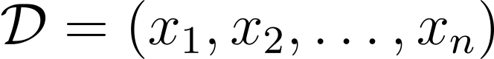
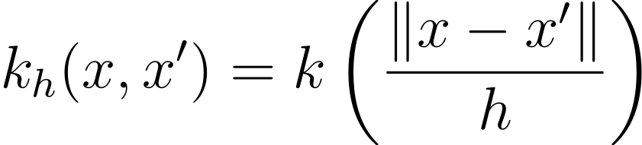
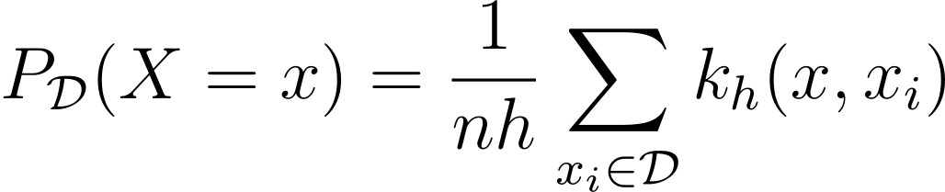
SSPs as Probabilities
Background
Kernel Density Estimators
From a dataset
With a kernel function
We can estimate the probability of x

Slide 24
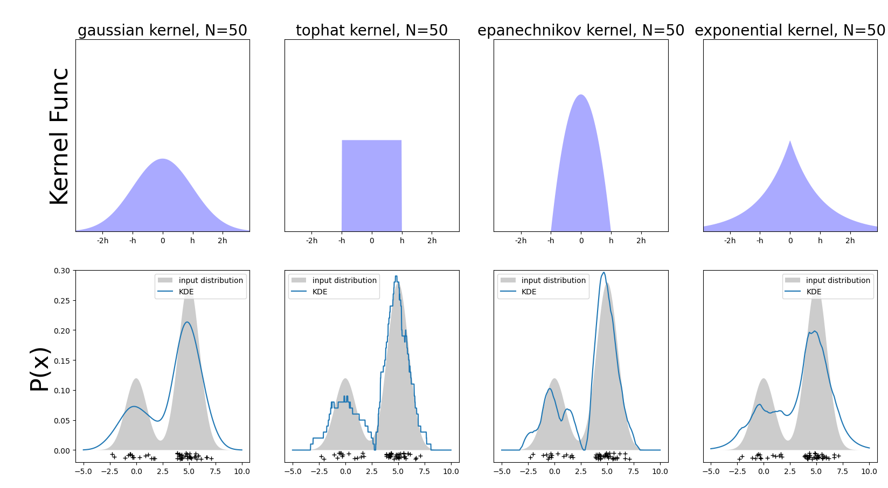
SSPs as Probabilities
Kernel Density Estimators Examples

Slide 25
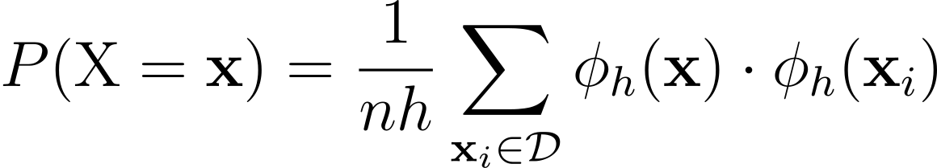
SSPs as Probabilities
Problems
KDE memory grows linearly with the number of observations
KDE time to compute a probability grow linearly with # of observations
But…
Not if your kernel is a dot product

Slide 26
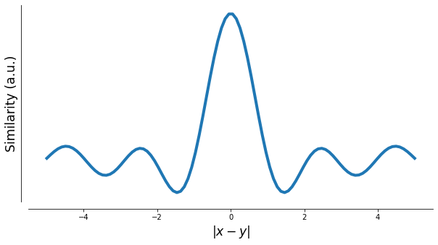
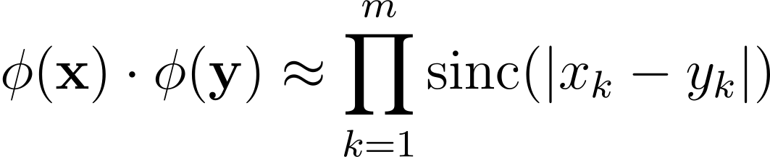
SSPs as Probabilities
SSPs induce a quasi-kernel
‘quasi’ because there are negatives

Slide 27
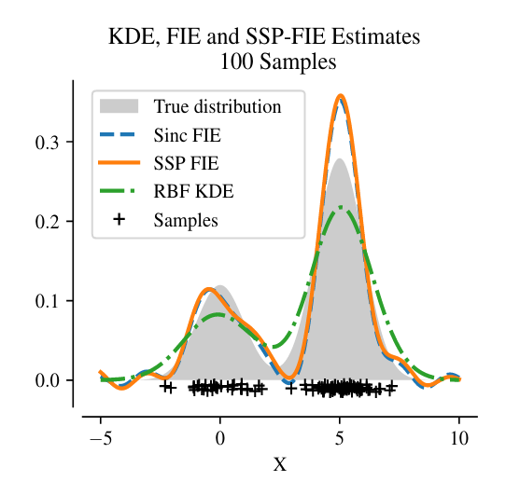
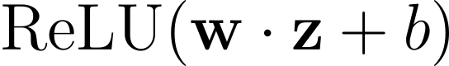
SSPs as Probabilities
Can convert to probability estimator
Glad et al, 2003

Slide 28
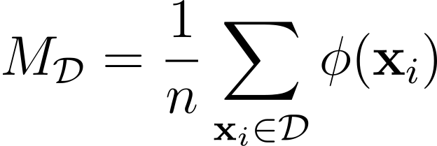
SSPs as Probabilities
So SSP memory is a latent probability distribution
The distribution is stored in bundles of vector symbols.
We can apply manipulations to bundles to produce probabilistic statements

Slide 29
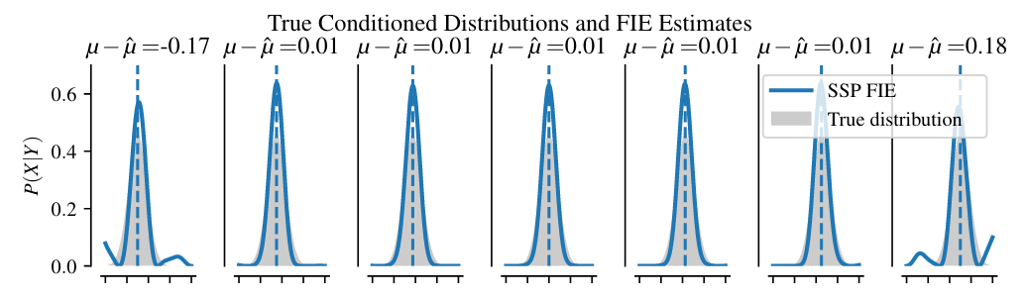
SSPs as Probabilities
Conditioning

Slide 30
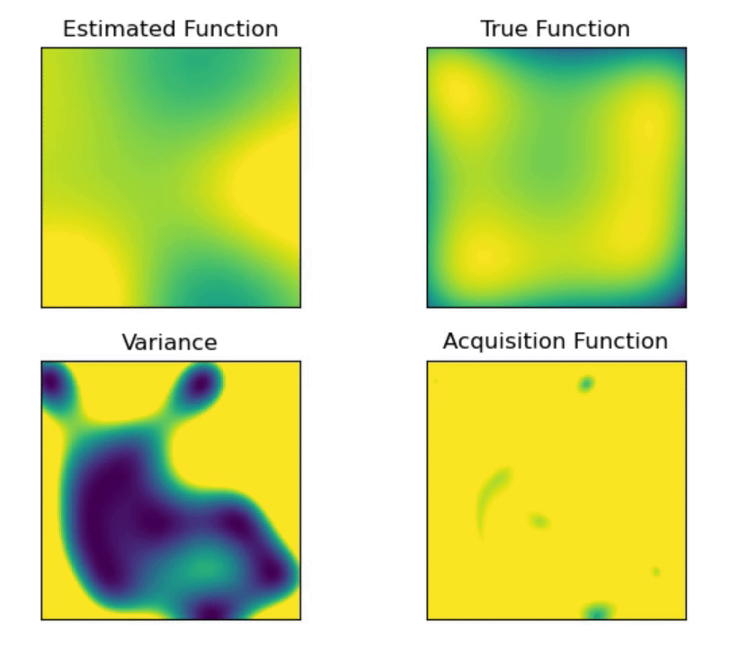
SSPs as Probabilities
Mutual Information (MI) is a common objective function used in exploration
Gaussian Processes (GPs) are a convenient, but computationally intensive tool for computing MI
We use Spatial Semantic Pointers and Bayesian linear regression to approximate a GP while improving in memory and time complexity
μ_{t}(x)
σ²_{t}(x)

Slide 31
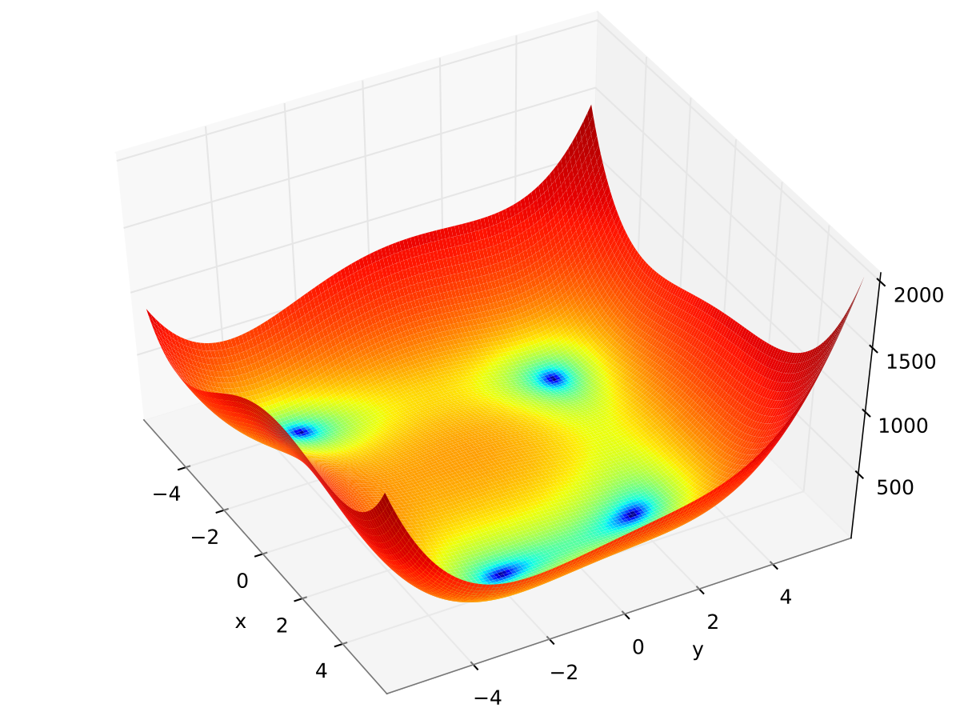
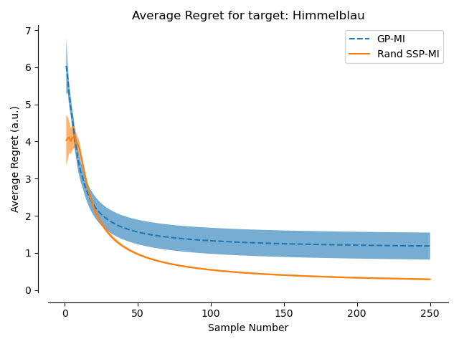
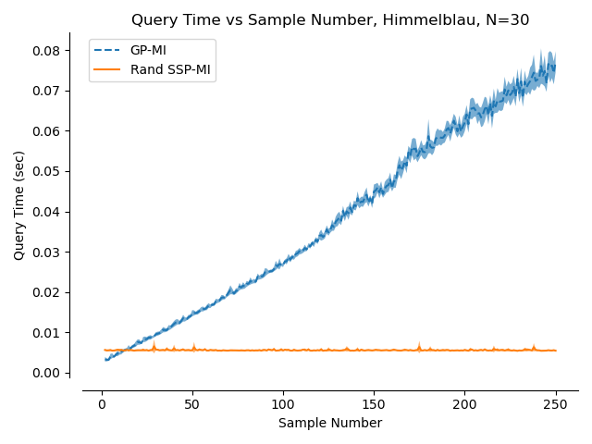
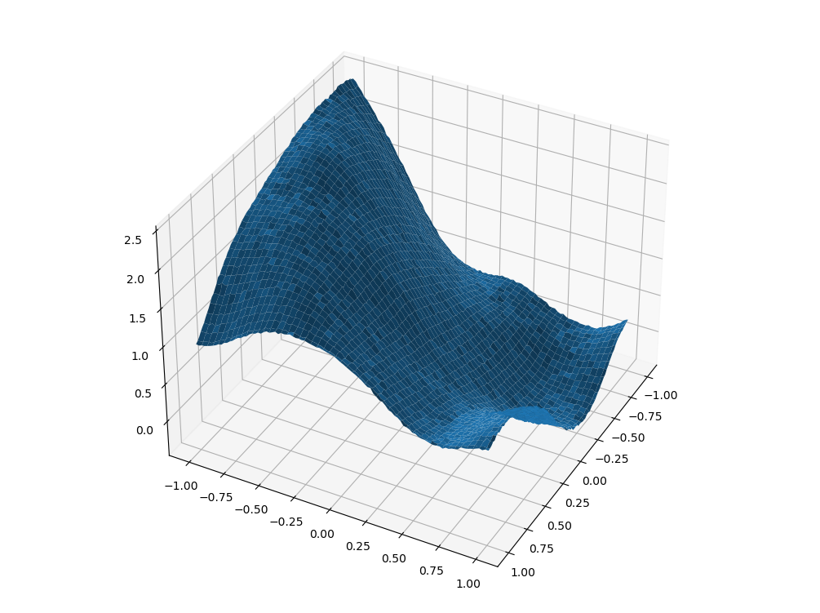
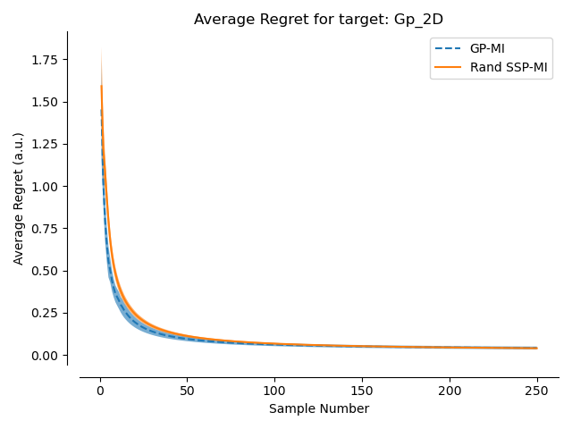
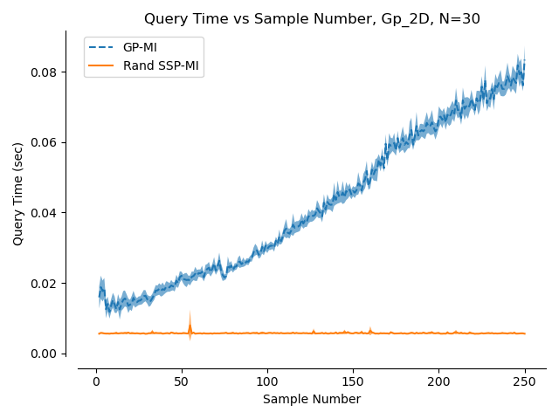
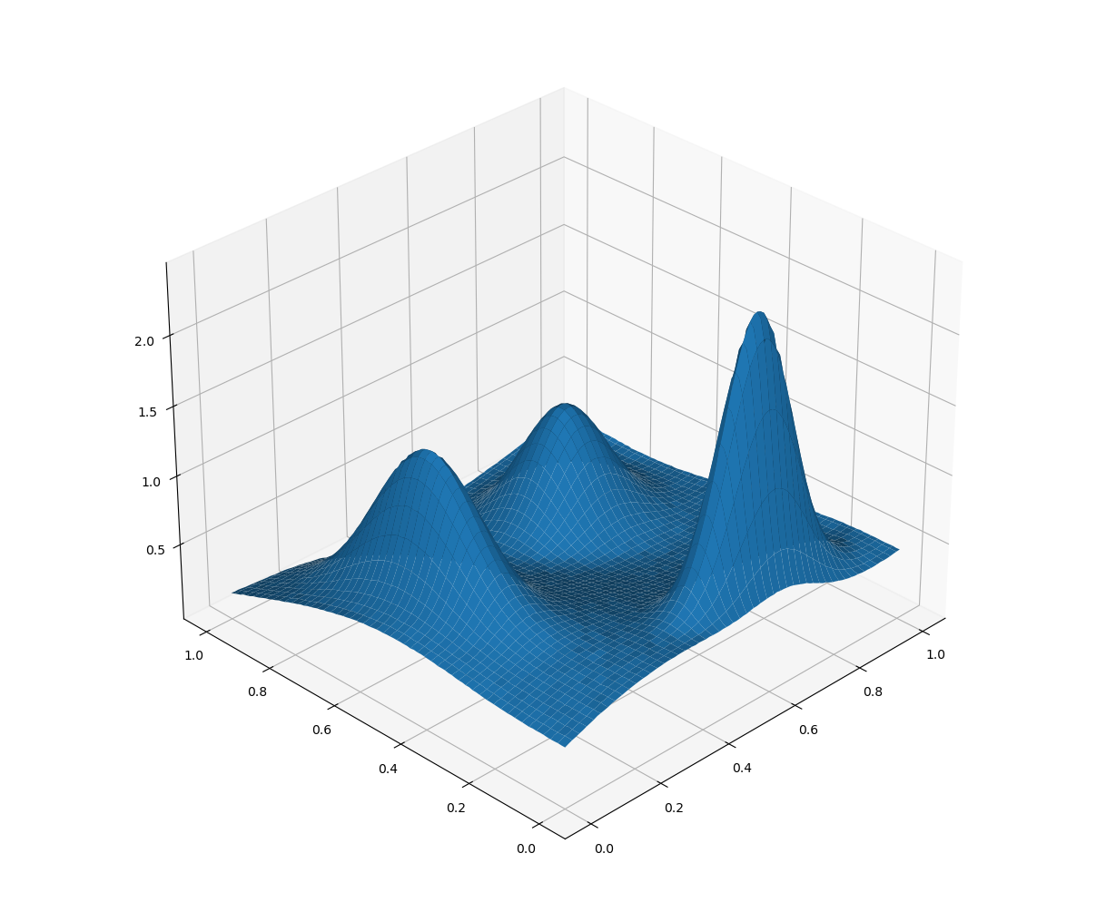
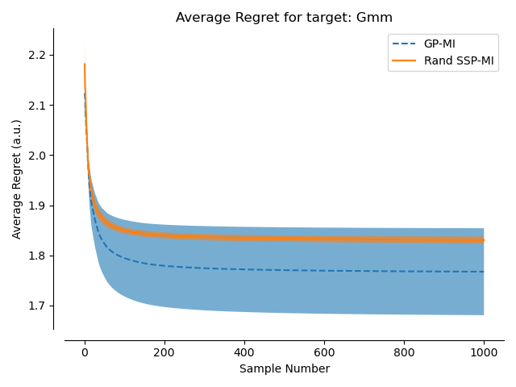
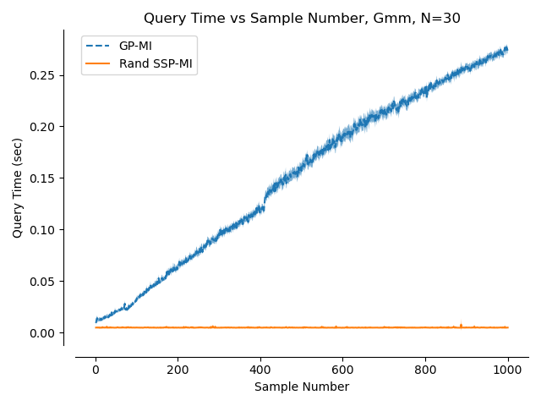
Results
Himmelblau Function
Sampled from GP with Matern Kernel + 1% noise
GMM with noise ~ (Matern Kernel + 1% noise)

Slide 32
SSPs as Probabilities
Where we differ:
Provide a general and abstract framework for modelling probabilities
Draw a direct connection between cognitive models and probability statements
Provide network architectures for conditioning, marginalization, entropy, and mutual information

Slide 33
Conclusion
SSPs support a variety of types of inference for cognitive models
Binding spatial and ‘symbolic’ representations
Representations of sampled data that can be used for probabilistic inference
Improves
Interpretability
Efficiency (SWaP critical)
Best engineered systems continue to learn from understanding biological solutions

Slide 34
List of Publications/Awards Attributed to the Grant
*Best cognitive modeling prize - Language* Peter Blouw and Chris Eliasmith. Inferential role semantics for natural language. In Thora Tenbrink, Glenn Gunzelmann, Andrew Howes and Eddy Davelaar, editors, Proceedings of the 39th Annual Conference of the Cognitive Science Society, 142–147. Philadelphia, Pennsylvania, 2017. Cognitive Science Society.
Peter Duggins, Terrence C. Stewart, Xuan Choo, and Chris Eliasmith. Effects of guanfacine and phenylephrine on a spiking neuron model of working memory. Topics in Cognitive Science, 2017.
Jan Gosmann, Aaron R. Voelker, and Chris Eliasmith. A spiking independent accumulator model for winner-take-all computation. In Proceedings of the 39th Annual Conference of the Cognitive Science Society. London, UK, 2017. Cognitive Science Society.
Jan Gosmann and Chris Eliasmith. Automatic optimization of the computation graph in the nengo neural network simulator. Frontiers in Neuroinformatics, 11:33, 2017.
Ivana Kajić, Jan Gosmann, Brent Komer, Ryan W. Orr, Terrence C. Stewart, and Chris Eliasmith. A biologically constrained model of semantic memory search. In Proceedings of the 39th Annual Conference of the Cognitive Science Society. London, UK, 2017. Cognitive Science Society.

Slide 35
List of Publications/Awards Attributed to the Grant
Ivana Kajić, Jan Gosmann, Terrence C. Stewart, Thomas Wennekers, and Chris Eliasmith. A spiking neuron model of word associations for the remote associates test. Frontiers in Psychology, 8:99, 2017.
Daniel Rasmussen, Aaron R. Voelker, and Chris Eliasmith. A neural model of hierarchical reinforcement learning. PLoS ONE, 12(7):1–39, 2017.
Peter Blouw and Chris Eliasmith (2018) Using Neural Networks to Generate Inferential Roles for Natural Language. Frontiers in Psychology.
Terrence C. Stewart, Sverrir Thorgeirsson, and Chris Eliasmith. Supervised learning of action selection in cognitive spiking neuron models. In 40th Annual Conference of the Cognitive Science Society, 1086–1091. Cognitive Science Society, 2018.
Sverrir Thorgeirsson, Terrence C. Stewart, and Chris Eliasmith. Analysis of learning action selection parameters in a neural cognitive model. In International Conference on Cognitive Modelling. 2018.
Sverrir Thorgeirsson, Brent Komer, and Chris Eliasmith. Incorporating an adaptive learning rate in a neural model of action selection. In Cognitive Computational Neuroscience. Philadelphia, USA, 2018.
Jan Gosmann and Chris Eliasmith. Vector-derived transformation binding: an improved binding operation for deep symbol-like processing in neural networks. Neural Computation, 31(5):849-869, 05 2019.

Slide 36
List of Publications/Awards Attributed to the Grant
Aaron R. Voelker and Chris Eliasmith. Improving spiking dynamical networks: accurate delays, higher-order synapses, and time cells. Neural Computation, 30(3):569-609, 03 2018
Brent Komer, Terrence C. Stewart, Aaron R. Voelker, and Chris Eliasmith. A neural representation of continuous space using fractional binding. In 41st Annual Meeting of the Cognitive Science Society. Montreal, QC, 2019. Cognitive Science Society.
Joost de Jong, Aaron R. Voelker, Hedderik van Rijn, Terrence C. Stewart, and Chris Eliasmith. Flexible timing with delay networks – the scalar property and neural scaling. In 17th Annual Meeting of the International Conference on Cognitive Modelling (ICCM). 2019.
Peter Duggins and Chris Eliasmith. A spiking neuron model of pharmacologically-biased fear conditioning in the amygdala. In SfN Abstracts. Chicago USA, 2019.
Aaron R. Voelker, Ivana Kajić, and Chris Eliasmith. Legendre memory units: continuous-time representation in recurrent neural networks. In Advances in Neural Information Processing Systems, 15544–15553. 2019.
Thomas Lu, Aaron R. Voelker, Brent Komer, and Chris Eliasmith. Representing spatial relations with fractional binding. In 41st Annual Meeting of the Cognitive Science Society. Montreal, QC, 2019. Cognitive Science Society.

Slide 37
List of Publications/Awards Attributed to the Grant
Andreas Stöckel, Terrence C. Stewart, and Chris Eliasmith. Connecting biological detail with neural computation: application to the cerebellar granule-golgi microcircuit. In 18th Annual Meeting of the International Conference on Cognitive Modelling. Toronto, ON, 2020. Society for Mathematical Psychology. ***Best paper award
Andreas Stöckel, Terrence C. Stewart, and Chris Eliasmith. A biologically plausible spiking neural model of eyeblink conditioning in the cerebellum. In 42nd Annual Meeting of the Cognitive Science Society, 1614–1620. Toronto, ON, 2020. Cognitive Science Society.
Brent Komer and Chris Eliasmith. Efficient navigation using a scalable, biologically inspired spatial representation. In 42nd Annual Meeting of the Cognitive Science Society. Toronto, ON, 2020. Cognitive Science Society.
Nicole Sandra-Yaffa Dumont and Chris Eliasmith. Accurate representation for spatial cognition using grid cells. In 42nd Annual Meeting of the Cognitive Science Society, 2367–2373. Toronto, ON, 2020. Cognitive Science Society.

Slide 38
List of Publications/Awards Attributed to the Grant
Jan Gosmann and Chris Eliasmith. CUE: a unified spiking neuron model of short-term and long-term memory. Psychological Review, 2020.
Narsimha Reddy Chilkuri and Chris Eliasmith. Parallelizing Legendre Memory Unit training. In Marina Meila and Tong Zhang, editors, Proceedings of the 38th ICML, volume 139 of Proceedings of Machine Learning Research, 1898–1907. PMLR, 18–24 Jul 2021.
Andreas Stöckel, T C. Stewart, and C Eliasmith. Connecting biological detail with neural computation: application to the cerebellar granule-golgi microcircuit. Topics in Cognitive Science, 13(3):515-533, 2021.
Joost de Jong, Aaron Voelker, Terry Stewart, Chris Eliasmith, and Heddrick van Rijn. A neurocomputational model of prospective and retrospective timing. In ICCM. Toronto, ON, 2021. Society for Mathematical Psychology.
Andreas Stöckel and Chris Eliasmith. Passive nonlinear dendritic interactions as a computational resource in spiking neural networks. Neural Computation, 33(1):96-128, 2021. PMID: 33080158.
Aaron R. Voelker, Peter Blouw, Xuan Choo, Nicole Sandra-Yaffa Dumont, Terrence C. Stewart, and Chris Eliasmith. Simulating and predicting dynamical systems with spatial semantic pointers. Neural Computation, 33(8):2033-2067, 07 2021.

Slide 39
List of Publications/Awards Attributed to the Grant
Andreas Stöckel and Chris Eliasmith. (2022). Computational properties of multi-compartment LIF neurons with passive dendrites. Neuromorphic Computing and Engineering. 2(2): 024011.
Peter Duggins and Chris Eliasmith. (2022). Constructing functional models from biophysically-detailed neurons. PLOS Computational Biology. 18(9): e1010461.
Brent Komer, Pawel Jaworski, Steven Harbour, Chris Eliasmith, Travis DeWolf. (2022). BatSLAM: neuromorphic spatial reasoning in 3D environments. IEEE 41st DASC, Portsmouth, United States.
Nicole Dumont, Jeff Orchard, Chris Eliasmith. (2022). A model of path integration that connects neural and symbolic representation. In 44th Annual Meeting of the Cognitive Science Society, Toronto, Canada.
Peter Duggins, Chris Eliasmith. (2022). Reinforcement Learning and Social Orientation Mediate Decision Making in the Trust Game. 44th Annual Meeting of the Cognitive Science Society, Toronto, Canada.
P. Michael Furlong, Chris Eliasmith. (2022). Fractional binding in vector symbolic architectures as quasiprobability statements. 44th Annual Meeting of the Cognitive Science Society, Toronto.

Slide 40
List of Publications/Awards Attributed to the Grant
Narsimha Chilkuri, Chris Eliasmith. (2022). Debugging using orthogonal gradient descent. ICML Updatable Machine Learning. International Conference on Machine Learning, United States.

